Slide 1
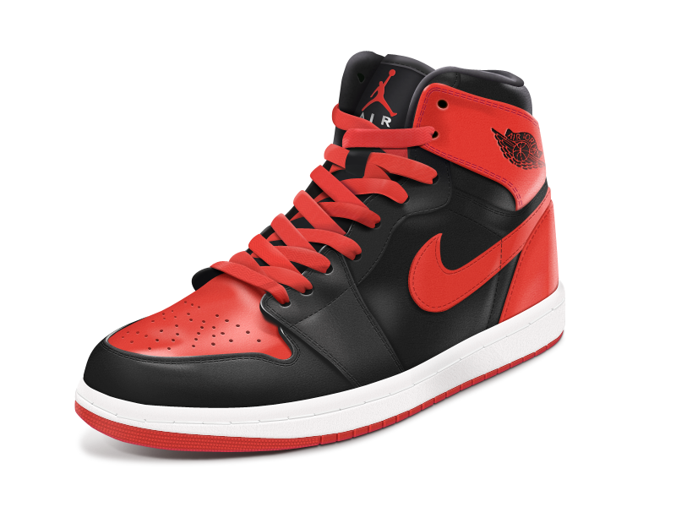
SNKRS Я US
Lorenzo Howard
Melissa Avila
Sheniece Booker
Fawn Payton

Slide 2
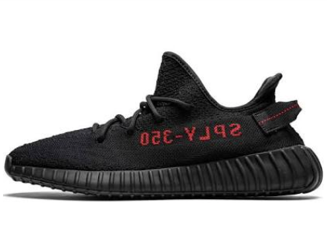
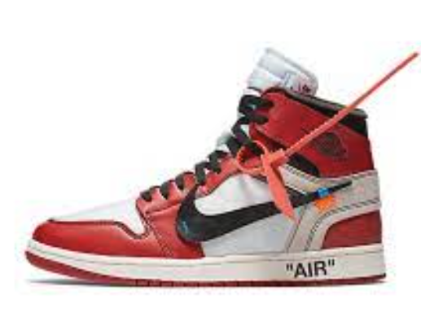
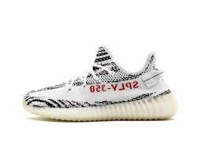
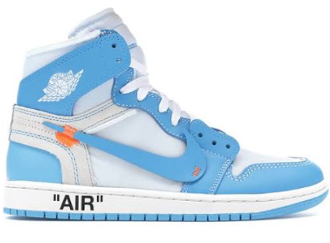
Table of Contents
3. Introduction – Case Study
02
4. Popularity Analysis
5-8. Sales Analysis
9. Statistical & Variance Analysis
10. Summary

Slide 3
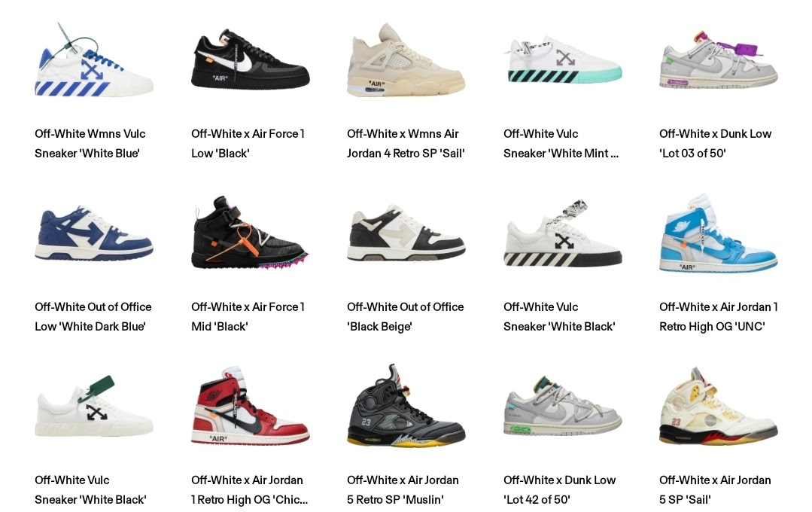
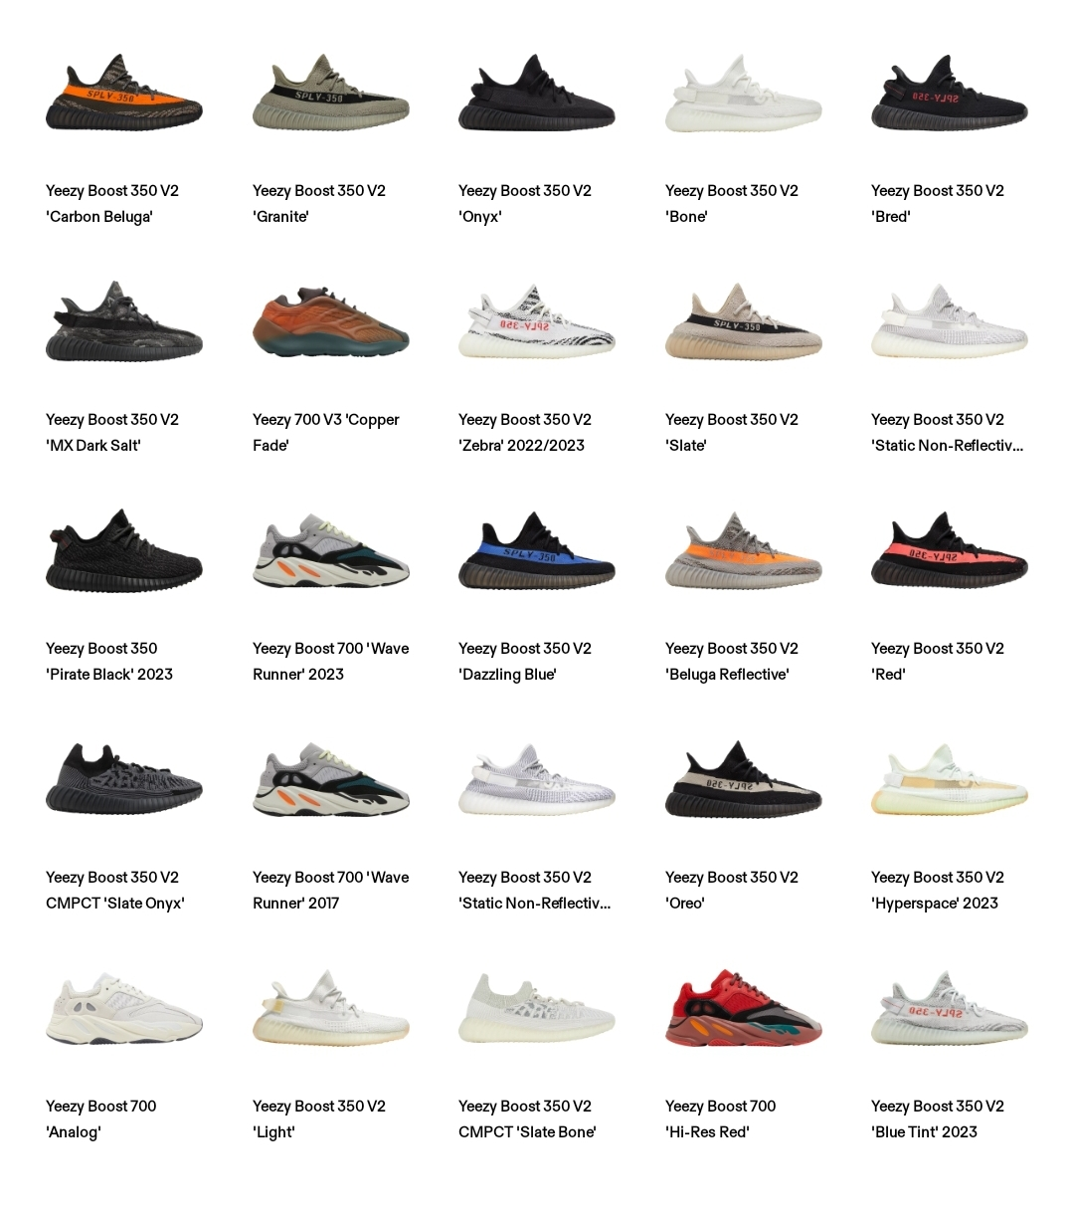
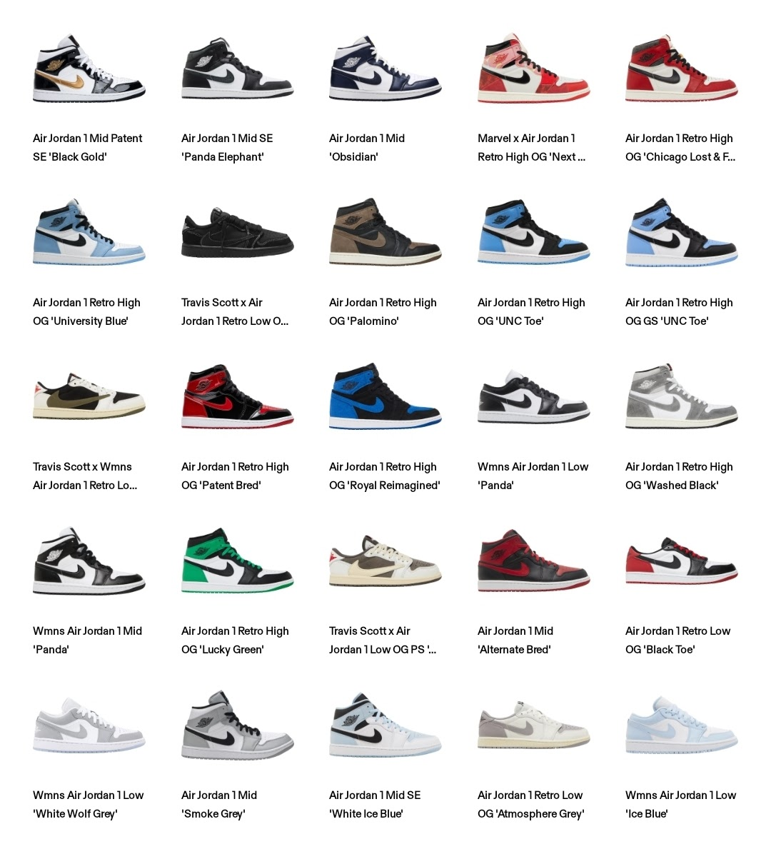
Introduction
SNKRS Я Us - Case Study
We are a sneaker store/distributor looking to potentially expand and service other regions outside of NJ.
The data used reflects which regions in the United States are top and low resellers in the "after market“, along with what brand and style sell the best.
The primary/retail market is where the sneakers are first released at the retail pricing (box price) to the general public via major retailers such as Footlocker, Nike stores, Adidas stores etc.
Popular sneakers, such as the ones in our data, usually come in a limited supply and sell out quickly. Because of this, many buyers miss out on the purchase opportunity which in turn creates a resell/aftermarket (secondary market). Those that were able to purchase the sneakers at "box price"/retail pricing are now in a position to gain a profit by selling the sneakers at much higher prices than retail. Sites/establishments such as StockX, GOAT and FightClub are major players in the secondary market.
03

Slide 4
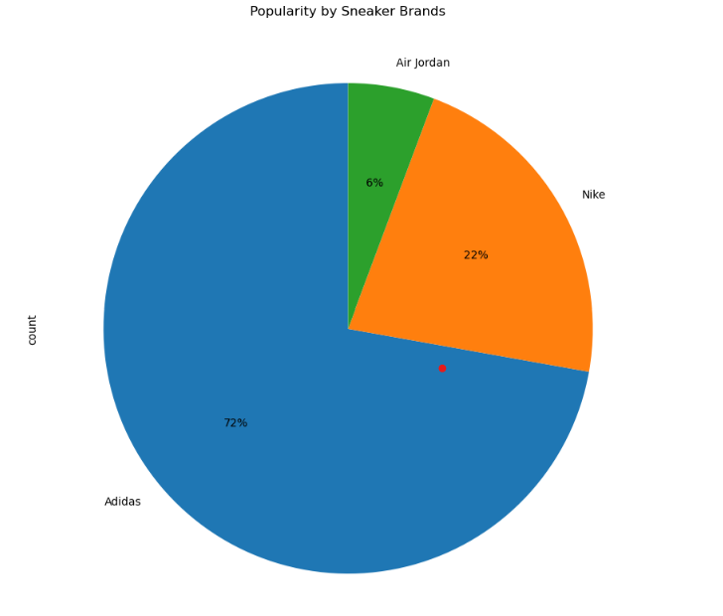
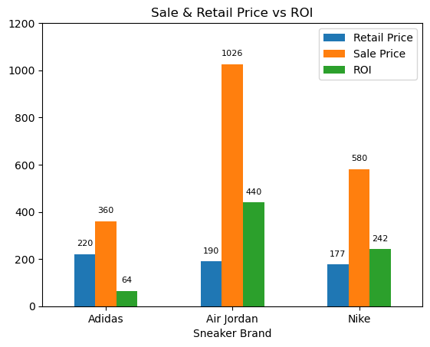
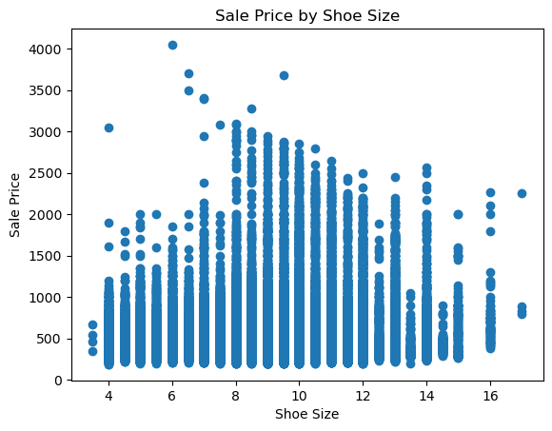
Popularity Analysis
Does popularity equate to profit?
Of the 4 brands of sneakers, Adidas is the most popular due to their fashion collaboration with Kanye West’s Yeezy Sneaker brand with 72% popularity.
Even though Adidas shows as being most popular to purchase, the Air Jordan sneaker brand re-sells at a higher price and holds a higher ROI over Adidas and Nike.
Shoe sizes 6-12 show as having the highest sales. Smaller shoe sizes are more expensive compared to larger shoe sizes.
04

Slide 5
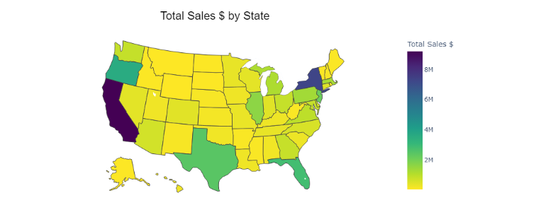
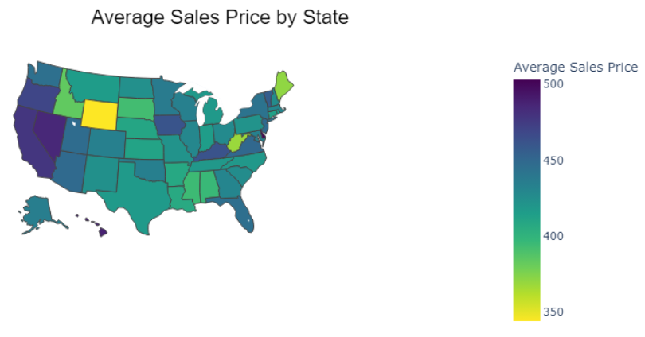
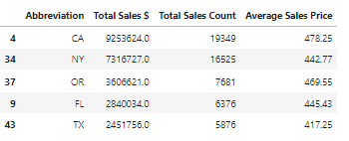
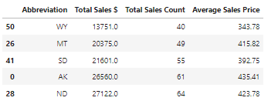
Sales Analysis
Does state size equate higher profits?
State size doesn’t equate to higher profits. Texas is the biggest state in the United States but ranks 5th in the in the top five of total sales by state: 1. California, 2. New York, 3. Oregon, 4. Florida, 5. Texas.
California tops the list with a total sales value of over $9 million dollars, with an average sale price of $478.25
The bottom five of total sales: 1. Wyoming, 2. Montana, 3. South Dakota, 4. Arkansas and 5. North Dakota
Wyoming having the lowest total sales of over $13,000 with an average sale price of $343.78.
05

Slide 6
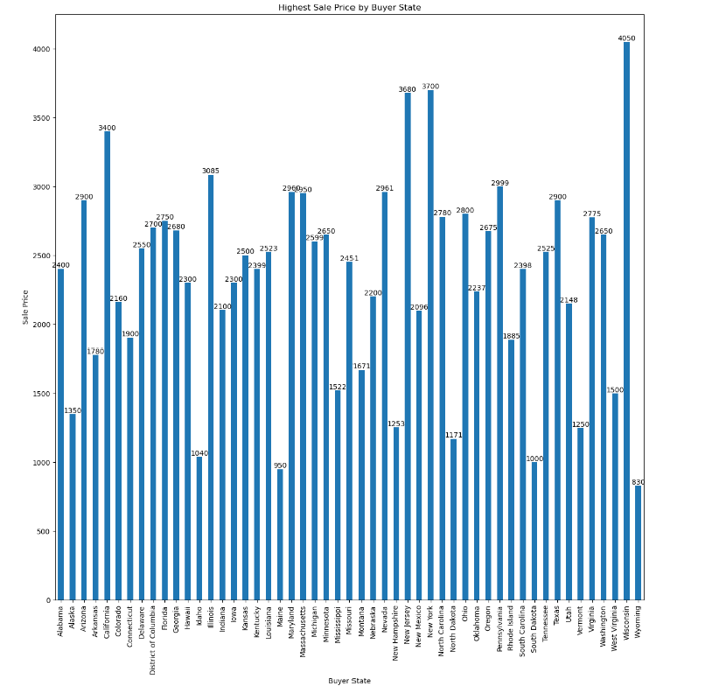
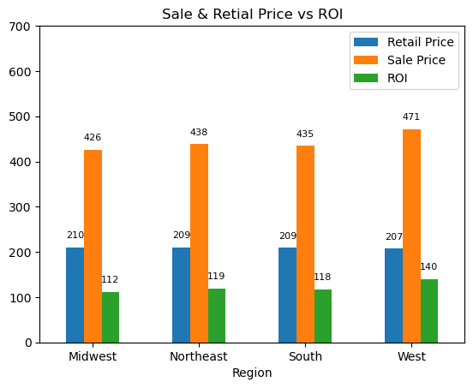
Sales Analysis
How impactful is the sales price on the ROI based on the state region?
06
The Midwest has the lowest ROI but had one of the highest selling sneakers
Air-Jordan-1-Retro-High-Off-White-Chicago sneaker sold for $190 and re-sold at $4,050 in a size 6 in Wisconsin.
The ROI is dependent on the sales price because the retail price is similar across all regions.
But the West and the Northeast regions have higher ROI because of their sales price.

Slide 7
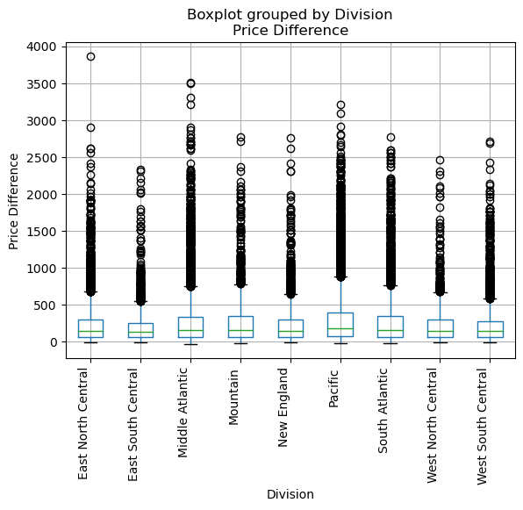
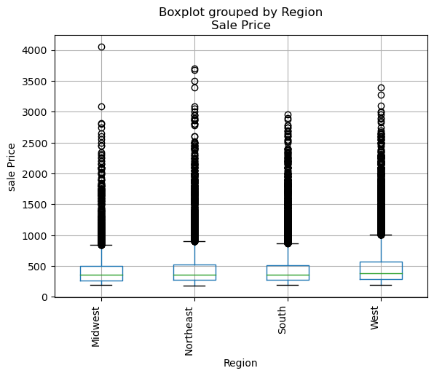
Sales Analysis
Does region or division impact sales price?
07
Yes, though there are significant outliers in the Midwest, the West still generally has a higher sales price. This can also be seen in by division

Slide 8
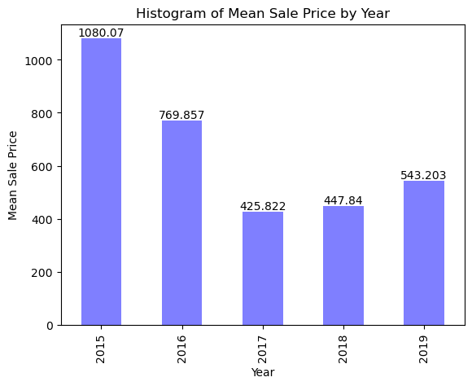
Sales Analysis
Does the sales price over time indicate volatility in the sneaker secondary market?
08
Since 2015 there has been a decline, but it began to rise again in 2018. This shows there is an opportunity to be profitable long term.

Slide 9
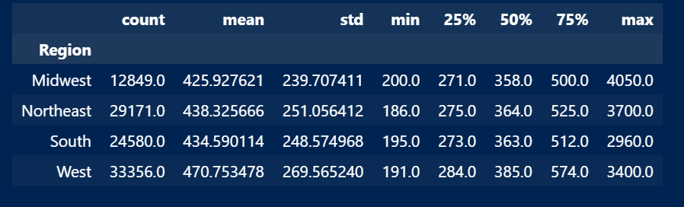
Statistical & Variance Analysis
What are the top three regions to target?
The ANOVA analysis provided a value of 155. 837 and indicates the means between the sales per regions are unique and high. The negative pvalue rejects the null hypothesis because the means are unique.
The top three regions to target will be 1.Northeast 2.West 3.South based on their rankings from the 75% quartile in sales from the statistical analysis.
09

Slide 10
Summary
10
Should we expand to other regions outside of NJ based on our analysis?
Yes, we should expand. There is profit opportunity in California, New York, Oregon and Florida and high ROI in the West and Northeast regions. High re-sale anomalies in areas such as Wisconsin is also encouraging, even though it ranked in one of the bottom sale regions. Opportunity based on historical trend indicates that the industry is profitable.
Given more time to analyze further data we would include analysis by sneaker brand sales per state, additional sneaker brands and include global ROI data.

Slide 11
Thank you!
Thank you!

